Slide 1
West Nile Virus Prediction
By: Solomon Heng, Ng Jun Kang, Preety Bhogal, Vaishnavi, Zoey Cheng
Disease And Treatment Agency (DATA)
Division of Societal Cures In Epidemiology and New Creative Engineering

Slide 2
Background
West Nile Virus (WNV) is most commonly spread to humans through infected mosquitos
In response to the recent epidemic in City of Chicago, Chicago Department of Public Health (CDPH) had established a surveillance and control program. The program entails setting mosquito traps, testing for WNV and spraying of airborne pesticides in the city
Centres for Disease Control and Prevention (CDC) has engaged DATA for the following services:
To conduct a review on the surveillance and control program through data analytics
To conduct a cost-benefit analysis on the annual cost projections for various levels of pesticide coverage and the effect of of these various levels of pesticide coverage

Slide 3
Presentation Scope
Aim
DATA’s Problem Statement
Intro to Datasets
EDA
Modeling and ROC AUC Curve
Cost Benefit Analysis & Possible Inferences
Conclusion & Recommendations

Slide 4
Aim
To provide CDC and CDPH an update on the data analytics study and cost-benefit analysis
To review the pesticide deployment plan
To seek CDC’s and CPDH’s support on DATA’s recommendations

Slide 5
DATA’s Problem Statement
To build a classification model with high sensitivity & specificity on the presence of WNV at a specific place and time so as to aid CDC in deriving an effective pesticide deployment plan
To conduct a cost-benefit analysis on the annual cost projections for various levels of pesticide coverage and the effect of of these various levels of pesticide coverage

Slide 6
Intro to Datasets
Datasets provided:
Data of 2007, 2009, 2011 & 2013
Data to predict on: 2008, 2010, 2012, 2014
Weather data: 2007 - 2014
Spray data: 2011 & 2013

Slide 7
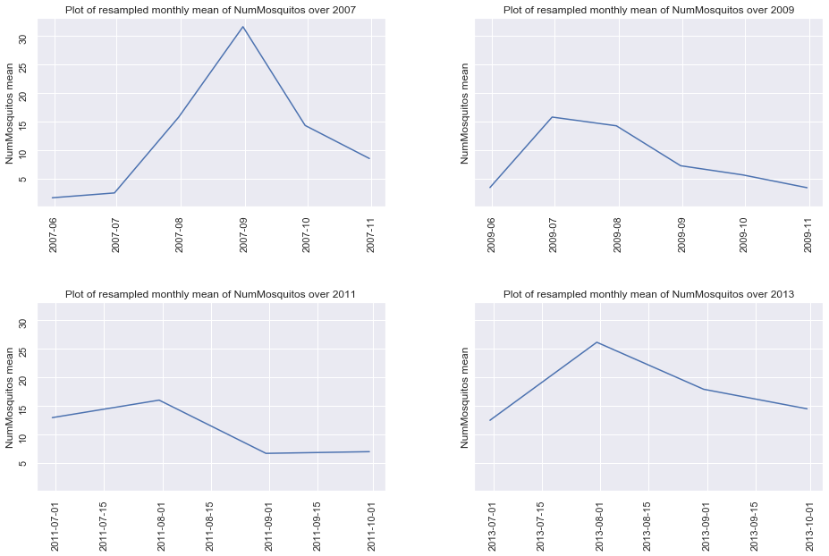
EDA
Notice how the number of mosquitoes usually picks up in July and start decreasing after September/October. Perhaps there is some sort of monthly seasonality when it comes to the mosquito counts.

Slide 8
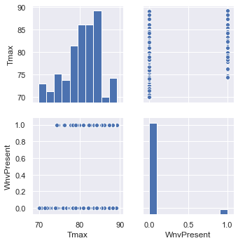
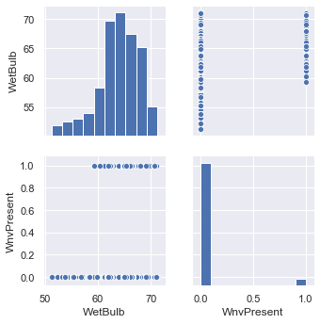
EDA
Higher temperatures -> Higher chance of WnvPresence
At low wetbulb temperature, there is no presence of WnV as well.

Slide 9
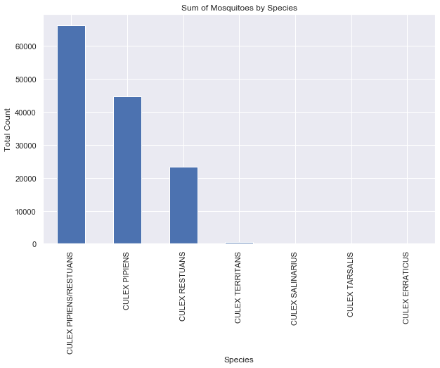
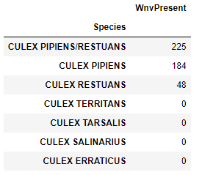
EDA
WNV is only present in 3 species groups of mosquitoes

Slide 10
Modeling
Modeling Process
Train-Test Split
Hyperparameter Tuning
Cross Validation
Test Prediction
Models and ROC AUC score
Kaggle score for Logistic Regression model with L1 Regularization: ~ 0.75
 | Cross Validation | Test
Logistic Regression | 0.893 | 0.737
Random Forest | 0.972 | 0.719
XGBoost | 0.984 | 0.635

Slide 11
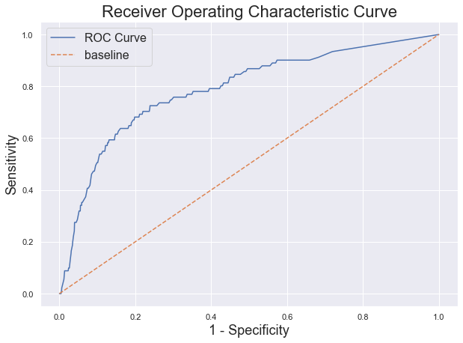
ROC AUC Curve

Slide 12
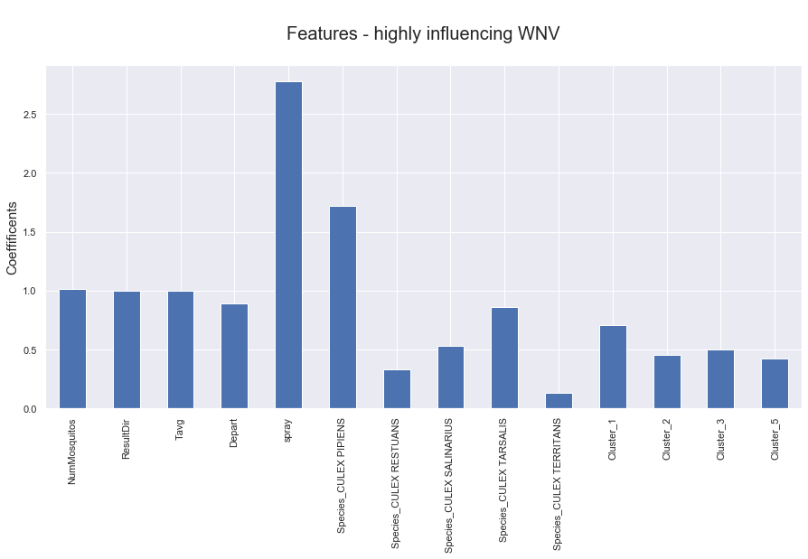
Cost Benefit Analysis-Possible Inferences
Based on the graph presence of, WNV has an inverse relationship with Spray

Slide 13
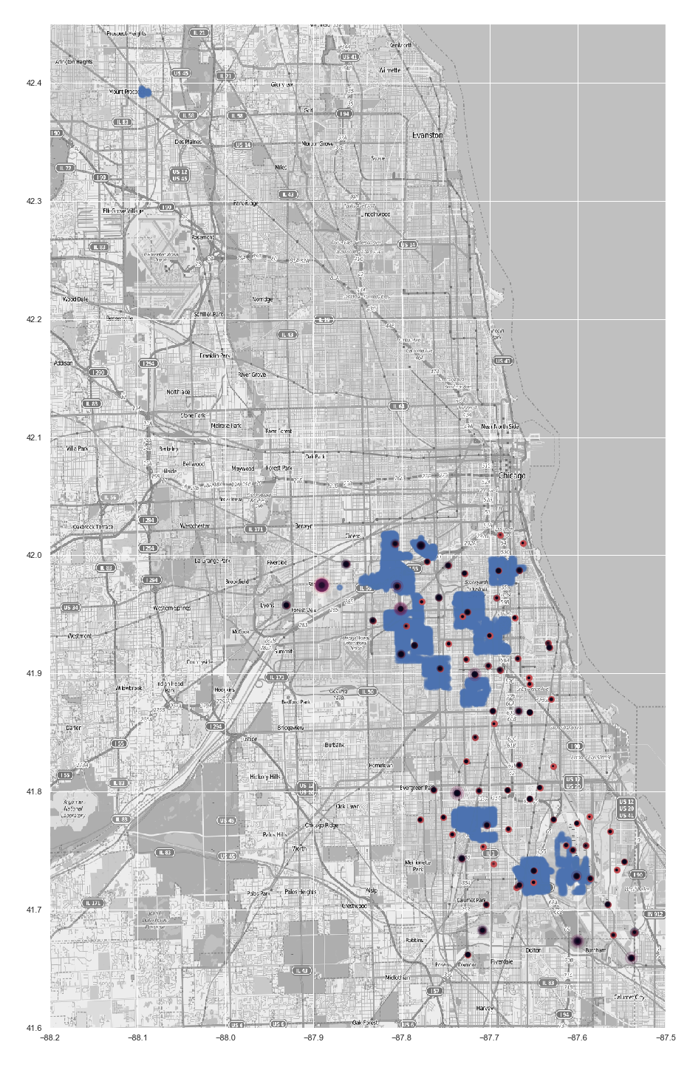
Possible Inferences
It might be because spraying was done on locations that does not have that many mosquitoes and WNV present.

Slide 14
Cost Benefit Analysis
The product used to control the adult mosquitoes in Chicago, Zenivex™
As per our calculations, the total estimated cost for Mosquito control spray is $6877.7 for an estimated area of 7037.14 acres and spray cost at unwanted locations is $ 4011.99(SPRAY COSTS)
A typical household with employer health coverage spends about USD 800 a year in out-of-pocket costs (MEDICAL COSTS)
BENEFIT - decreases medical expenses for residents in Chicago, fewer people being infected with mosquitos, people taking few or no medical leaves.

Slide 15
Conclusion
DATA’s EDA, Modeling & CBA arrives at the following conclusion:
EDA shows that while it is true that dry condition (low wet bulb temperature) and hot temperature is more favourable for presence of WNV,
High mosquito counts (approx 1500) shows that the presence of WNV is almost guaranteed
2 species (CULEX PIPIENS & CULEX PIPIENS/RESTUANS) of mosquitos exceeded the count of 1000
WNV is only seen in 3 mosquito species groups: CULEX PIPIENS/RESTUANS, CULEX PIPIENS and CULEX RESTUANS
High likelihood that not all species of mosquitoes found in the trap will carry WNV
Effectiveness of current pesticide deployment plan might not be optimal as the emphasis is not on areas with high mosquito counts or presence of WNV

Slide 16
Recommendations
CDC and CDPH to support the following recommendations:
New pesticide deployment plan which places more emphasis on areas with high mosquito counts or presence of WNV
DATA to further narrow the study to the control of CULEX PIPIENS & RESTUANS mosquitoes for a period of 12 months as the EDA shows these are the main carriers of WNV
Attachment of 2 x DATA data warehouse engineers to aid in the data collection process for spray datasets for a period of 12 months

